Slide 1

Recognition and Resources: the role of advocacy and lobbying
Kathryn Reilly
Policy & Legislative Affairs Manager
Irish Heart Foundation
kreilly@irishheart.ie

Slide 2
Who is this for?
Anyone involved in advocacy or looking to influence policy or legislation
This session has been developed to share an insider-outsider perspective on how to succeed in influencing policy or legislative change.

Slide 3
Understanding/ knowledge building
The Oireachtas
The budgetary calendar and process
How to make the most of the Oireachtas process

Slide 4
Influencing – how to effect change
Defining your issue and policy/legislative solution
Setting goals and objectives
Identify the target audience and who to influence
Stakeholder mapping and building partnerships/alliances
Creating effective communications

Slide 5
What might you take from today?
The challenges and opportunities in securing Government funding for services and how to achieve this.
Who are the key actors to influence locally and nationally.
How to agree, deliver and tailor clear messaging and how to do this consistently.
The effectiveness of working in coalition.

Slide 6
The challenges and opportunities in securing Government funding for services
Challenges:
Competition for funding
Bureaucracy
Changing political priorities
Budget constraints
Short term funding cycles
Political and Policy changes

Slide 7
The challenges and opportunities in securing Government funding for services
Opportunities
Alignment with Government priorities
Partnerships and Collaboration
Demonstrating impact
Innovation and efficiency
Advocacy and relationship building
Adaptability and flexibility

Slide 8
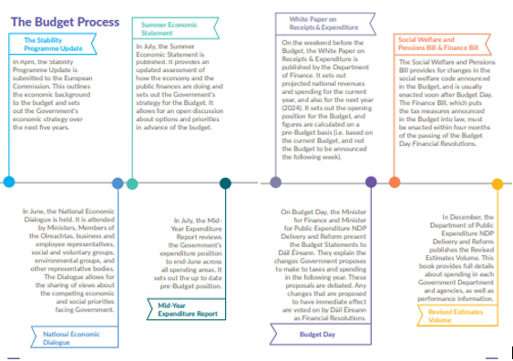
Understanding the Budgetary Process

Slide 9

Roles & Access points in the Budgetary Process
The officials
The politicians
  Government – feed into their Ministers
  Opposition – pre budget submissions
  Committees

Slide 10

Year-Round Advocacy

Slide 11
Policy Analysis and Research
“But what is the evidence for X??”

Slide 12
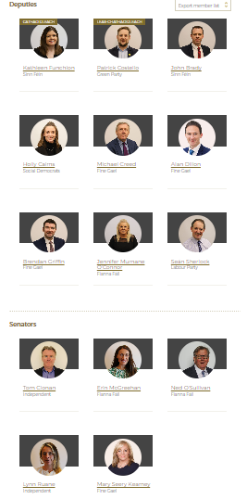
Who are the key actors to influence locally and nationally?
All politics is local. Who are your representatives?
Who is talking about the issue in the Oireachtas?
Spokespeople – Government and opposition in both houses
Oireachtas Committee
3. Who is making policy in the Department?
4. What other actors do you need to talk to?

Slide 13


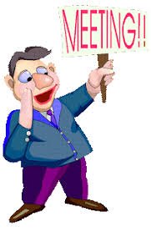

Community Engagement

Slide 14
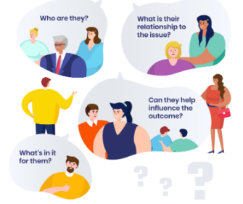
How to agree, deliver and tailor clear messaging and how to do this consistently

Slide 15
Partnerships and Collaborations
Strength in numbers.
Benefits of having more than 1 group saying the same thing.
Legitimacy in alliances. Become the “go to” and consulted, especially by Departments.
Better chance of audiences to receive messaging – Committees, Department meetings, Ministerial meetings
Be wary of the Alliance without administrative support – good intentions rust. Need to have support/secretariat to keep alliance alive

Slide 16
