Slide 1

Vision for Youth Work
Aspect 6: Quality, Relevance and Responsiveness
With
Dr. Hilary Tierney, CYRD, Maynooth University
and
Áine Ferris, Scouting Ireland
8th Dec 2023

Slide 2
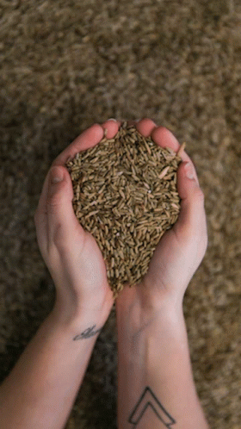

Youth work policy, provision
and practice rests on and
is informed by a clear
commitment to reflection,
monitoring and evaluation,
research and evidence, all
in a manner that respects
and involves young people
themselves; thus helping to
ensure that it remains attuned
to the changing needs and
circumstances of young
people while consistently
delivering to the highest
standards.
Reflection: how do we create spaces of reflection with young people?
Monitoring, evaluation and reporting: how do we know that youth work, is working?
Research and evidence: how can research support the development of quality youth work provision and practice?
A coordinated approach
to research-How do we do this?

Slide 3




Measuring Impact of Youth Organisations
Case Study for:
Vision for Youth Work
Aspect 6: Quality, Relevance and Responsiveness

Slide 4









Slide 5
MIYO PROJECT
Develop tools to ‘measure the impact of youth work’ on young people
Approach: develop an online digital survey along with focus group qualitative research
Intention is to make the Survey and Excel Analysis template, Focus Group Guides and resources available to the youth work sector in early 2024

Slide 6
Impact, Outcomes etc
Outcomes often more defined and short term e.g. what kind of change has occurred
Impact can tell us more about how a programme or project or intervention affected participants’ lives, their community, environment and society in both expected and unexpected ways in the longer term – broader scope over time
Outcomes and Impact are interlinked and sequential

Slide 7
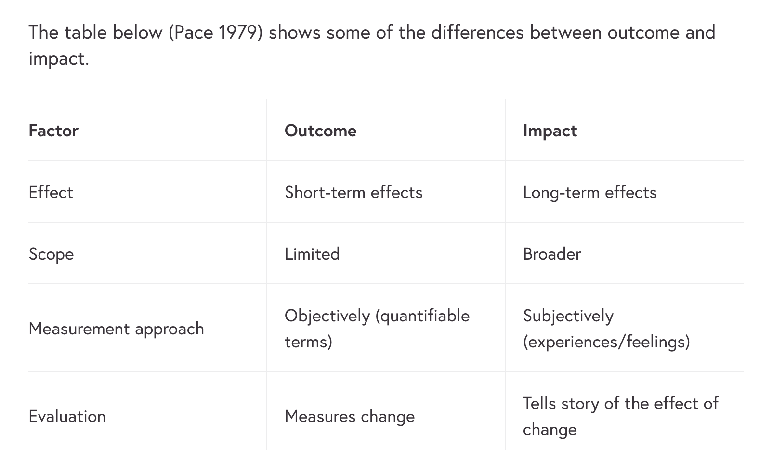
Pace, C.R. (1979) Measuring Outcomes of College. Fifty Years of Findings and Recommendations for the Future. San Francisco: Jossey-Bass Inc.

Slide 8
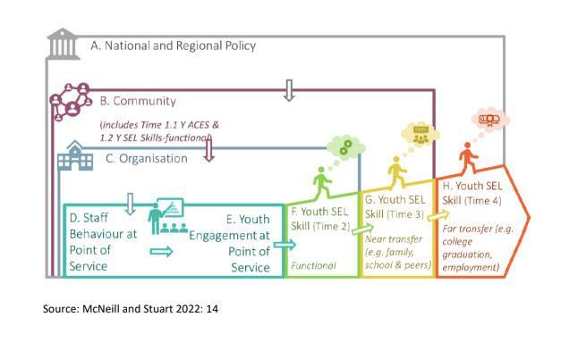

Proposed framework: Theory of Change

Slide 9
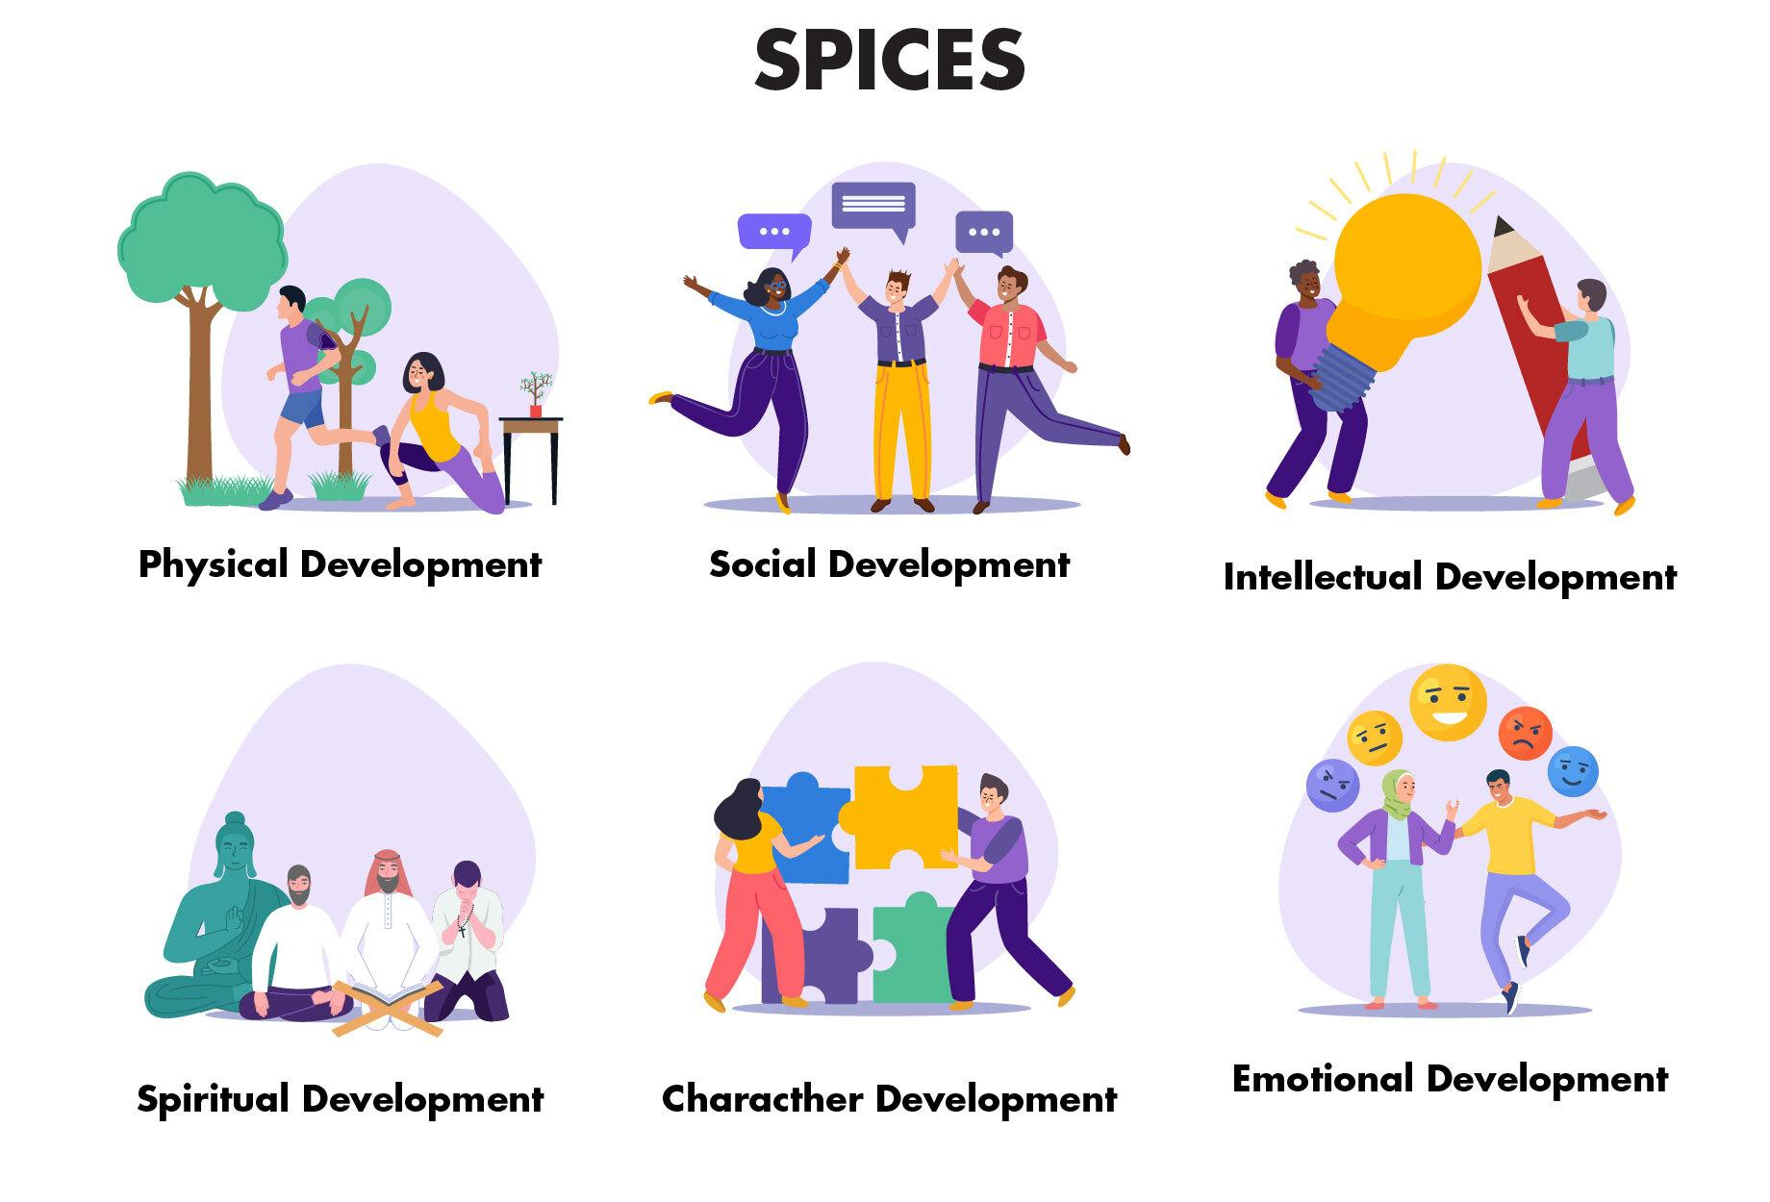
2. DEVELOPMENT OF IMPACT MEASUREMENT TOOLKIT AND FIRST ROUND OF PILOT TESTS

Slide 10
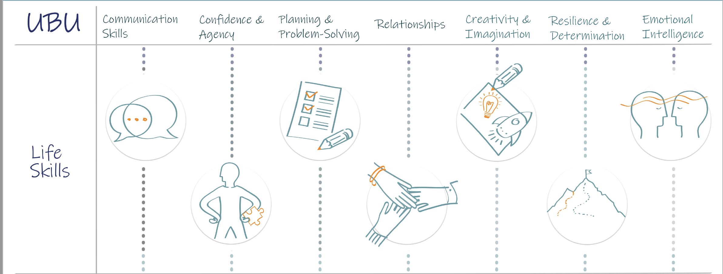
Personal and Social Outcomes of Youth Work in Ireland

Slide 11


2. DEVELOPMENT OF IMPACT MEASUREMENT TOOLKIT AND FIRST ROUND OF PILOT TESTS
METHODOLOGY
SURVEY
Self-perception statements
tackling all areas of personal growth
MS Teams, Google Forms etc
FOCUS GROUPS
In-depth discussions with young people
14-18 years old for the pilots

Slide 12
MIYO Online Survey
Anonymous (think about issues of consent /data protection)
Focus on young people 14-18 years old
Two parts and 45 Questions
Part 1 – Demographics (location, background, age, parental occupation, gender, religion, length and frequency of involvement etc.)
Part 2 – Statements
Statement 1(a), 2(a) etc - about individual experiences, qualities and skills. You are asked to consider the extent to which each statement is true of you.
Accompanying statement – 1(b), 2(b) etc - which relates to your organisation/project. You are asked to consider how true that statement is in your own case.
For all of these statements, please assign a score on a scale from 1 to 10, where 1 means “Not true at all” and 10 means “Absolutely true”.

Slide 13
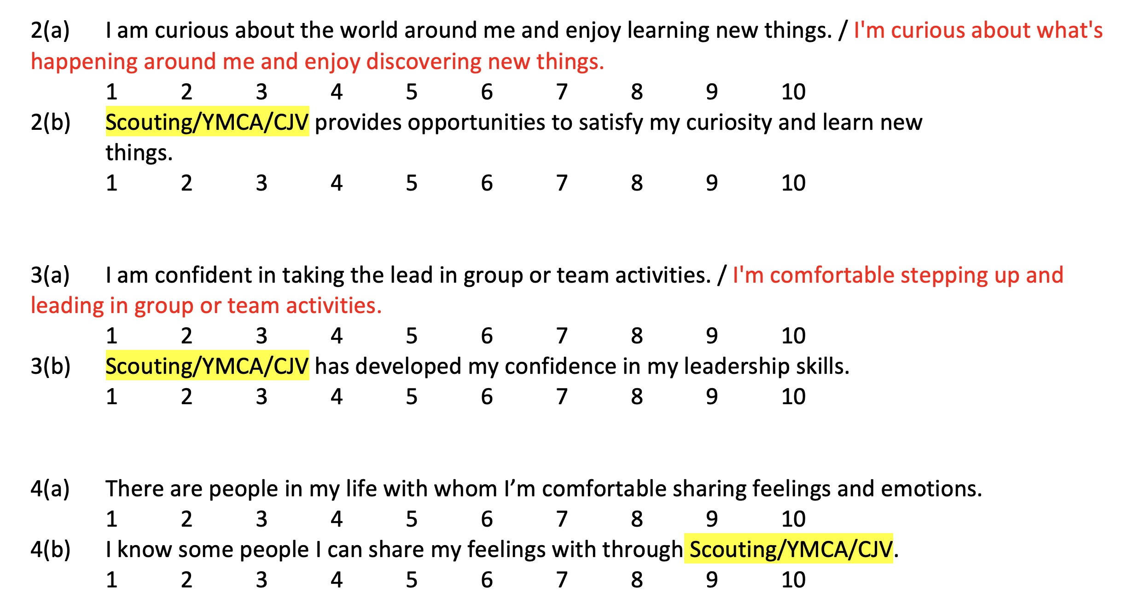
Sample of survey statements

Slide 14
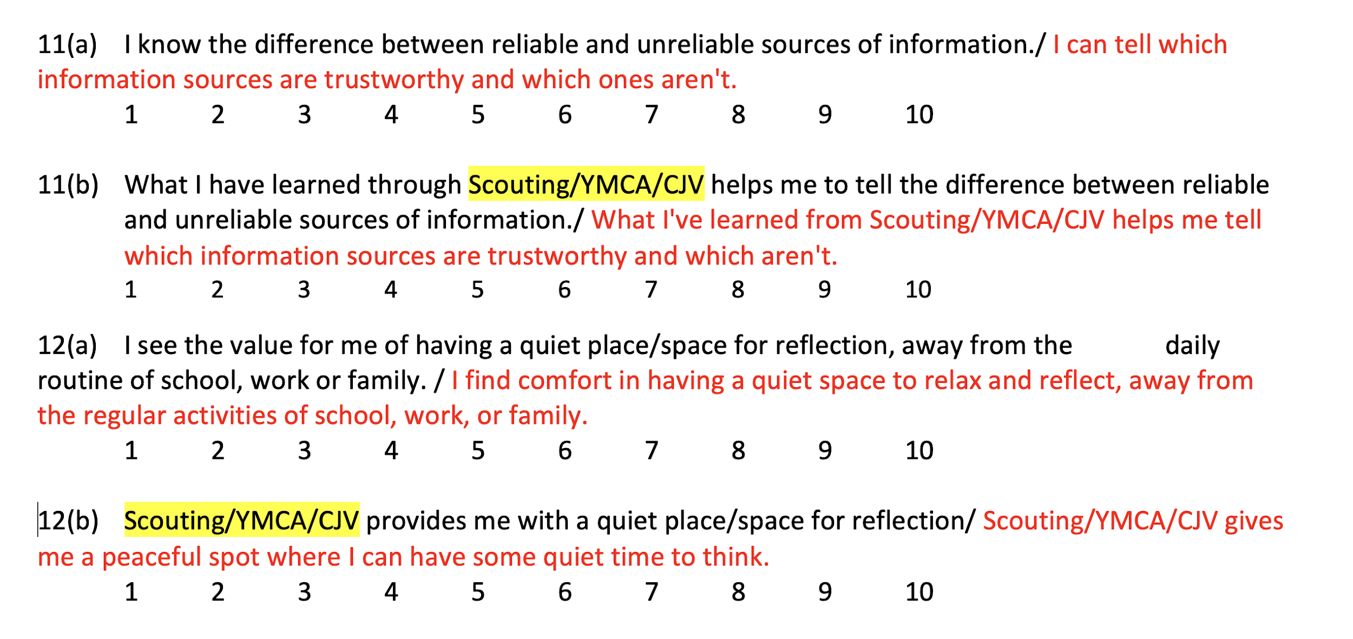

Slide 15
A Short Guide for Conducting a Pilot Study
Survey Translation and Digitalization: Translate the survey questionnaire into the local language of the youth organisation and digitise it for online distribution – thinking about sampling.
Moderator Recruitment: Recruit moderators/facilitators from within the organisation or local community for focus group interviews.
Data Collection and Input: Gather data from the survey and focus groups as per guidelines and input quantitative data into the provided Excel template.
Data Analysis: Analyse survey data using the Excel template and interpret focus group discussions following content analysis guidelines.
Presentation of Findings and Application: Prepare and present a report on the research results to showcase your impact to donors/funders, parents, and the local community. Use the insights gained to enhance and tailor your educational offer to young people.
Trainer Guide available here.

Slide 16
Report on Pilot 1
Report available at the MIYO website at this link
p.72. ‘… (give) further thought both to ways of assessing learning and development of different types and also to ways of enabling young people to become more aware of the learning and development that is taking place. This is important for several reasons:
educational science shows that people learn more effectively when they consciously reflect on what they are learning;
(b) the more aware young people are of what they have learned through Scouting/youth work the better placed they will be to put such learning to good use, e.g. in educational and job applications;
(c) the more explicitly young people can articulate their learning, the greater the promotional and reputational benefits for the organisations.

Slide 17

MIYO Project website https://impactofyouth.org/

