Slide 1

Communicating the Benefits of Youth Work
Martina Quinn, Founder and MD,
Alice Public Relations

Slide 2
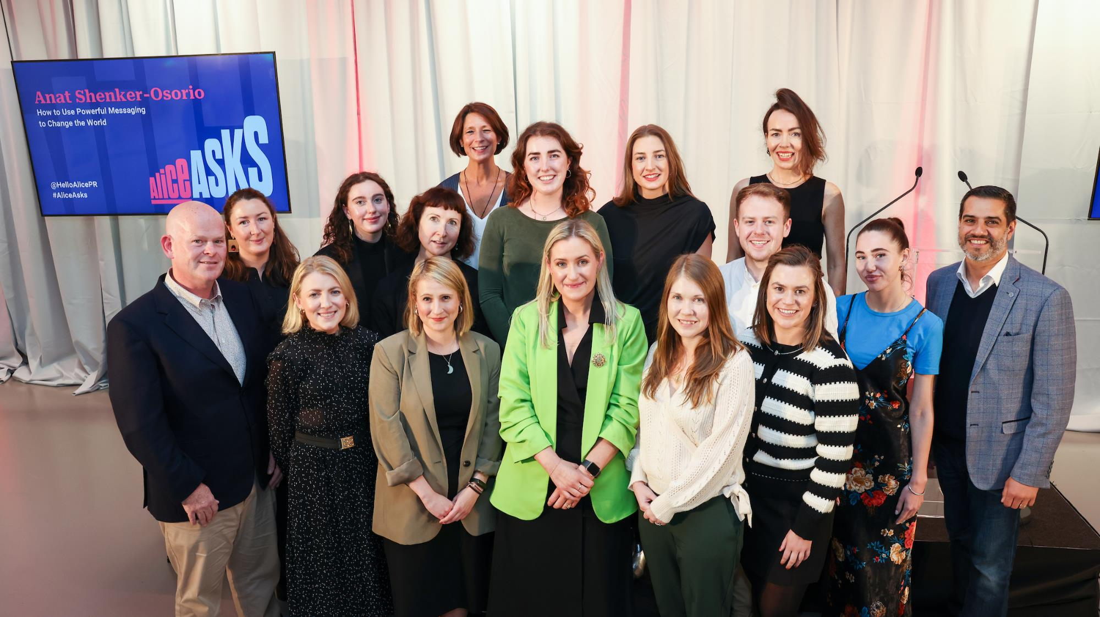

Slide 3
























Slide 4
Opportunities to highlight the benefits of youth work…

Slide 5

Media interviews.
Speaking engagements.
Social media.
Political meetings.
Meetings with other stakeholders, including funders.

Slide 6

What are people looking for?
Immediacy; timeliness.
Relevant, tailored and succinct information.
Human-interest stories (case studies).
A fresh / different / exclusive angle.
Visuals (opportunities for strong photo or TV / video footage).
Information they cannot get anywhere else.

Slide 7
Preparing Your
Key Messages

Slide 8

Understand Your Audience
Think about your audience’s
Size
Age range
Gender identities
Educational levels
Occupations
Cultural mix
And then tailor your content accordingly.

Slide 9
Do Your Research
Familiarise yourself with the set-up for your interview of speaking engagement.
Watch or listen to the show beforehand – or check out the publication that the interview will feature in – so you’re familiar with the style.
Do a rehearsal with a friend / colleague in advance.
Anticipate key questions, possible challenges or negative issues that may arise, and prepare responses.
Check out what’s in the news that day – are there stories or issues that might come up during your interview / speaking engagement?

Slide 10
Establish Your Key Messages
Have 2-3 concise key points – don’t try to squeeze too much in.
What is the single most interesting or newsworthy point about your activity / initiative / event? What is new or different about it?
Use ordinary language – no jargon / abbreviations / acronyms. Imagine you are talking to a 12-year-old child who knows nothing about your work.
Prepare some 20-second soundbites (newsrooms love them!).
Storytelling and emotional appeals are far more effective than facts and figures.

Slide 11
The basics of
good storytelling…

Slide 12
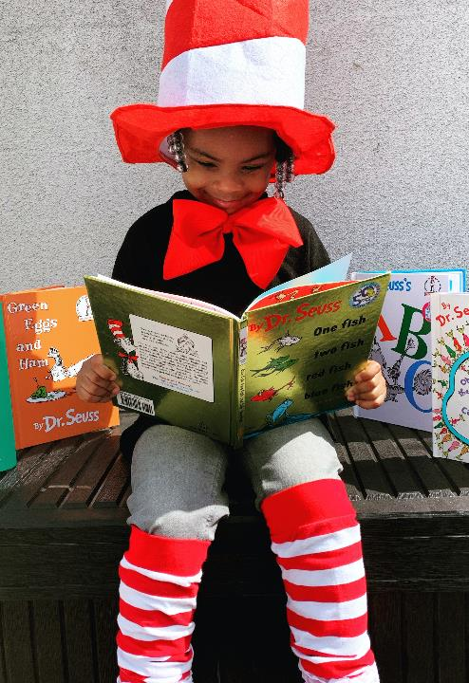
Good stories…
Are clear and concise.
Have a beginning, a middle and an end.
Use ordinary language.
Are compelling.
Are credible and authentic.
Are relatable.
Are relevant.

Slide 13
A good story needs to have a purpose…

Slide 14
What’s the purpose of telling this story?
Who are you trying to reach?
What do you want them to do in response? What are you trying to achieve?
Will this story resonate with your target audience(s)?

Slide 15
Everyone in your organisation has a role to play in sourcing stories that communicate the benefits of youth work…
Notes:
You all have a dual role:
To share your own stories to promote youth work; and
To identify other people’s stories that could achieve this aim – i.e. case studies.

Slide 16
PR / comms teams can’t promote good stories if they don’t have them!
Ensure staff in all roles and at all levels are informed about how and why case studies are important– and the process for informing your comms team re. same.
Develop a system for identifying and documenting case studies – that suits your organisation.
A short questionnaire can be helpful in capturing people’s details and their willingness to do different types of publicity.
The media generally prefer people to be identified (and photographed), rather than featuring anonymous stories.

Slide 17
Invest in supporting people to tell their stories well…

Slide 18
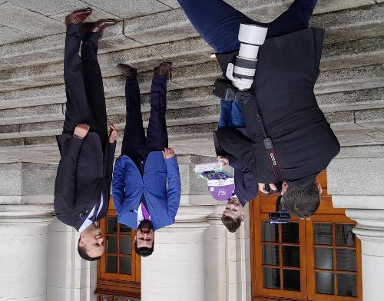
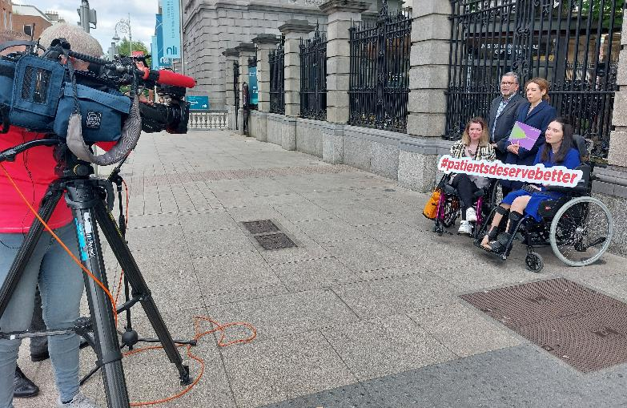
Ensure those sharing their stories are fully briefed about what exactly is being asked of them and are giving their informed consent.
Consider using a consent / release form.
Vet case studies before putting them forward for any public comms: assess their suitability for different types of engagements and exposure.
Provide them with media training and / or any other supports they might need to effectively tell their story.
Ensure they understand how their story relates to your cause – and are briefed, as appropriate, on your policy asks.
Manage their expectations.
Follow up with them afterwards.
Notes:
The Taoiseach with Matthew Kennedy, a person with CF, and his father Luke
Rosie Mangan, patient representative; Tony Wilkinson, Cork Parkinson's Association; Mags Rogers, Executive Director of the NAI; Laura Reid, patient representative;

Slide 19
Creative Storytelling
Consider whether there are more creative and interactive ways to convey your stories, for example…
Exhibitions.
Films or documentaries.
Theatre performances.
Installations / graffiti.
Interactive events.

Slide 20

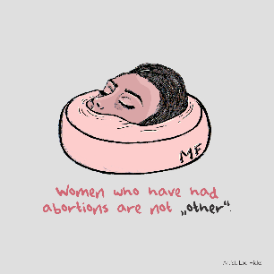
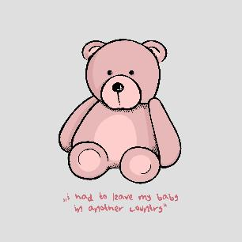


Slide 21


Slide 22
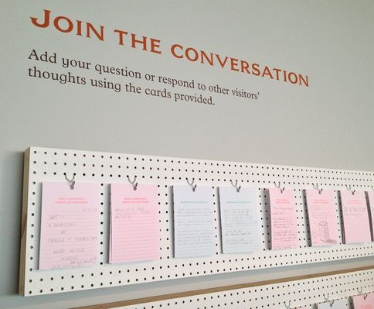

Slide 23
The Essentials
At a minimum, make sure you can describe your work well: what you do; who you work with; what you are trying to achieve. (Use Plain English!)
Tell your story (beginning, middle and end).
Establish your credentials / expertise: length of time doing what you’re doing; lived experience; why you got into youth work; why you’ve stayed!
Successes to date; goals for the future.
Call(s) to action.

Slide 24
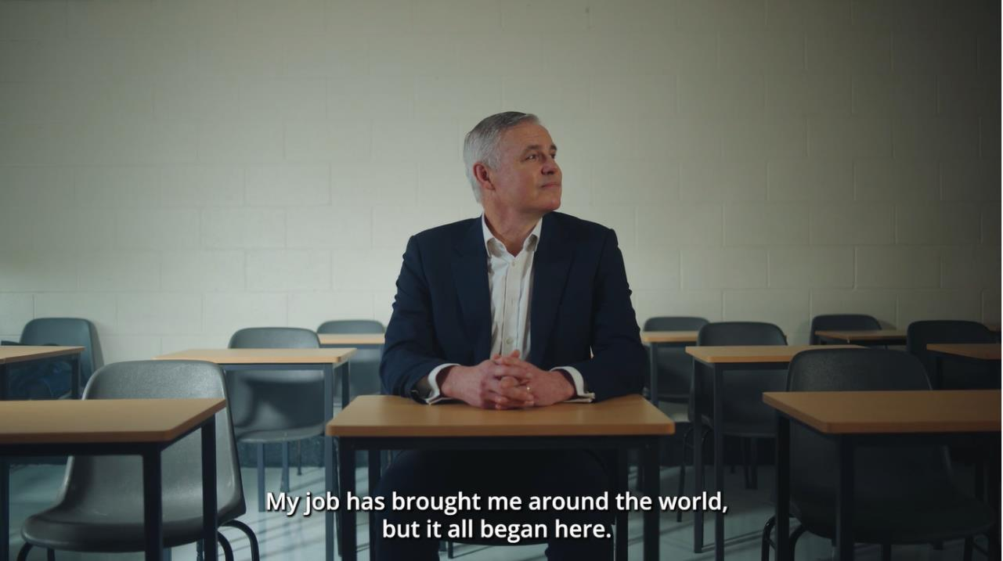
Notes:
https://www.etbi.ie/video/etb-heroes-master-video/

Slide 25
www.alicepr.com
martina@alicepr.com
@HelloAlicePR
@MartinaPQuinn

Slide 26
© Alice Public Relations 2023

