Slide 1
Access and Opportunity: Equality and Equity

Slide 2



Framing Inclusive and Responsive Practice
SELF-AWARENESS AND CRITICAL REFLECTION
FOSTERING CHANGE
THE BIG PICTURE
THE SOCIAL AND POLITICAL CONTEXT

Slide 3
What are we doing today?
Context for our work with young people
Panel discussion with Kate O Connell (NYCI) and Danni McKenna (Rialto Youth Project)
Reflection and Discussion
Reflecting on what we hear in the discussion how do we progress youth work practice to meet the challenge of emerging needs?
Critical thinking & Planning for change
What could advance and strengthen an equity approach across the youth work sector?

Slide 4
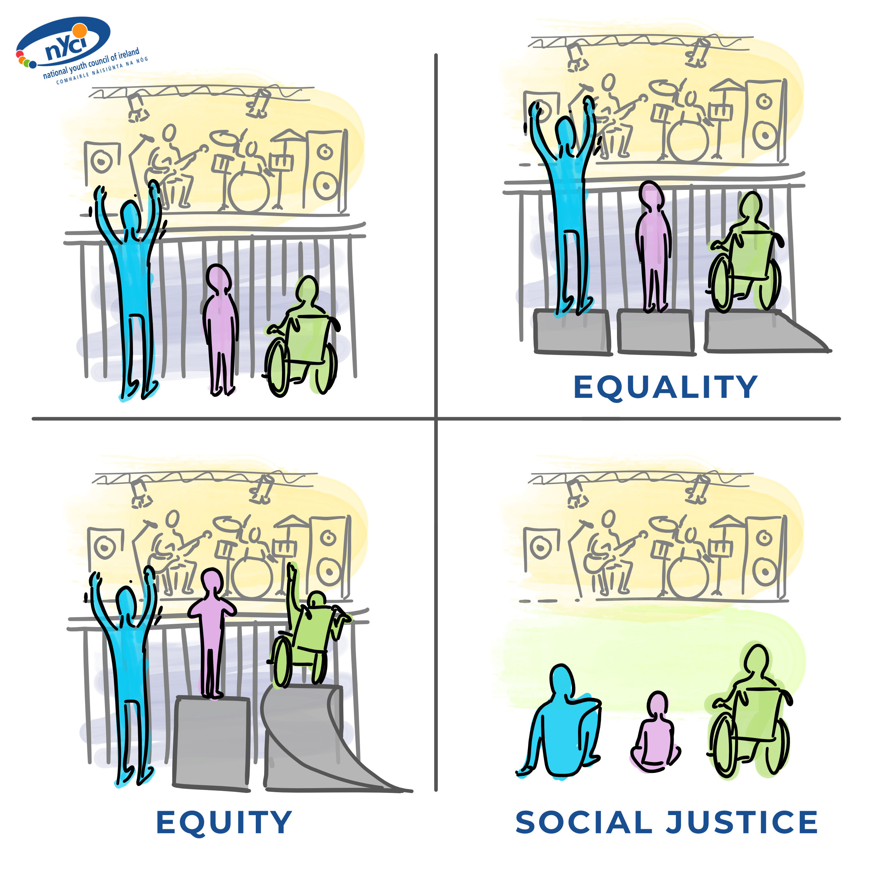
INEQUALITIES / INJUSTICES

Slide 5

Principles of Social Justice:
Access (greater equality of access to goods and services)
Equity (overcoming unfairness caused by unequal access to economic resources and power)
Rights (equal effective legal, industrial and political rights)
Participation (expanded opportunities for real participation in the decisions which govern their lives)
Diversity (recognition and respect of differences )
Social Justice
Access
Equity
Rights
Participation
Diversity

Slide 6
The Quadrant of Oppression
Oppression
Individual
Structural
Historical
Institutional

Slide 7
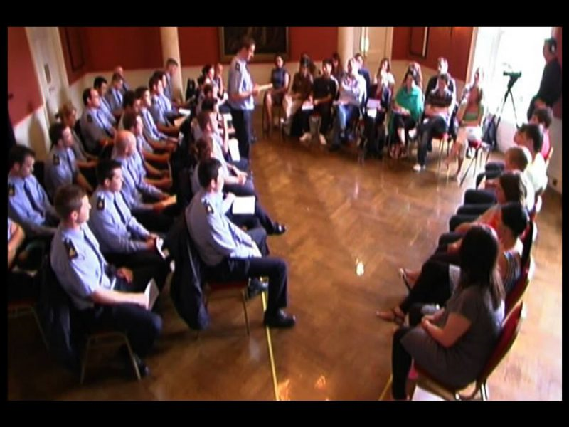
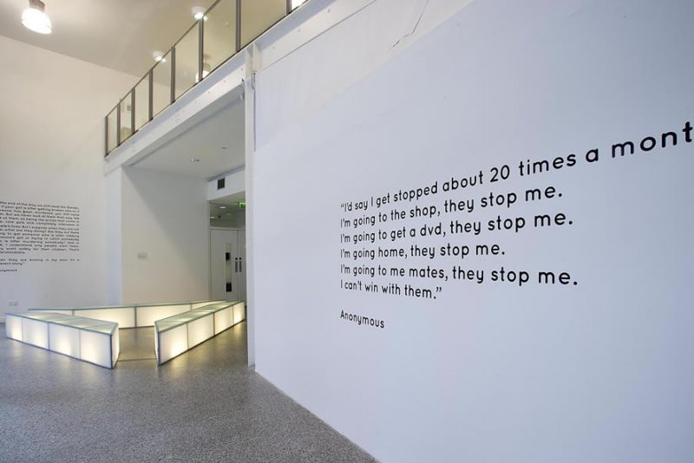
Policing dialogues

Slide 8
Reflecting on what you just heard
How do we progress youth work practice to meet the challenge of emerging needs?
Think here about practice development, new ways forward, other practices you know of that work, ideas about next steps, naming other emerging needs etc….

Slide 9
Thinking with a visionary mindset, about what you want to happen:
What could advance and strengthen an equity (and social justice) approach across the youth work sector?

Slide 10
“The Brave Space Invitation” by Beth Strano
Together we will create brave space
Because there is no such thing as a “safe space” —
We exist in the real world
We all carry scars and we have all caused wounds.
In this space
We seek to turn down the volume of the outside world,
We amplify voices that fight to be heard elsewhere,
We call each other to more truth and love
We have the right to start somewhere and continue to grow. We have the responsibility to examine what we think we know.
We will not be perfect.
This space will not be perfect.
It will not always be what we wish it to be
But
It will be our brave space together,
and
We will work on it side by side.

Slide 11
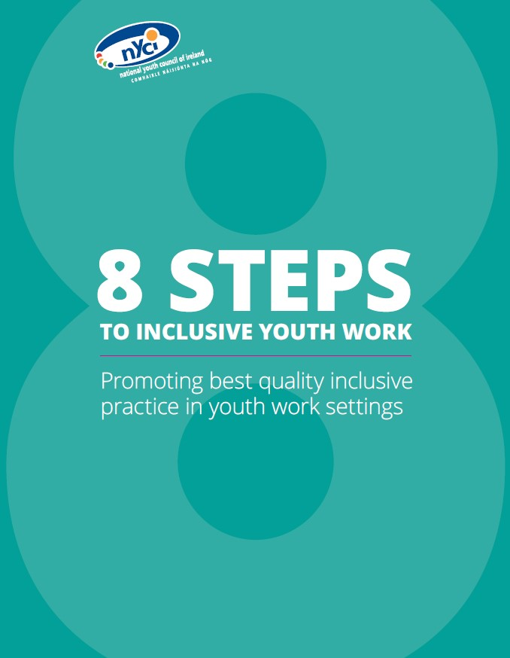


THANK
YOU
Anne Walsh
anne@nyci.ie

